Slide 1
Data Digest
Team Members-
Isha
Bikash
Abhishek

Slide 2
Data Digest
Team Members-
Isha
Bikash
Abhishek

Slide 3
Problem Statement:
What are the best ways to start in the field of Data Science and ML and the ways of staying strong in this field?

Slide 4
Dataset:
We have been given a dataset in which seems like a survey talking about the ways to get started with Data Science and what are the different aspects that are required for a Data Scientist to do their everyday work.

Slide 5
Part 1:-
What are the best ways to start in the field of Data Science and ML?
=>We have sorted out some features that can help us identify the ways to start a career in the field of Data Science, these include:-

Slide 6
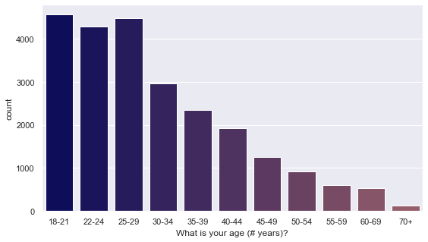
1) Age Range:-
From the plotted bar graph, we see that the people in the age range 18-21 years has started Data Science and ML earlier than other groups.

Slide 7
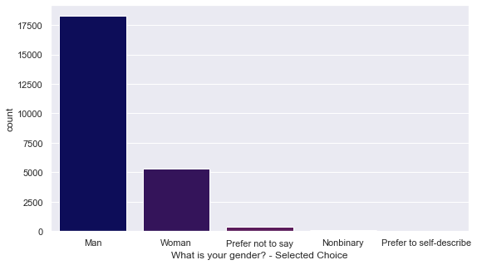
2) Gender:
Here from our data analysis the gender that dominates the field of ML and Data Science is Male.
Probably the reason behind this is the higher nationwide internet usage rate among men than women, at respectively 57.1 percent of male population and 33.3 percent of female population (as per 2021)

Slide 8
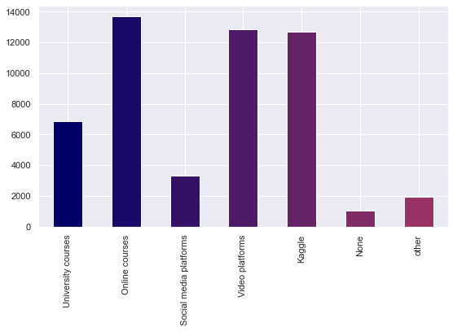
3) What products or platforms did you find to be most helpful when you first started studying data science?
It is evident from the graph that the beginners love to start their Data Science journey through online courses.

Slide 9
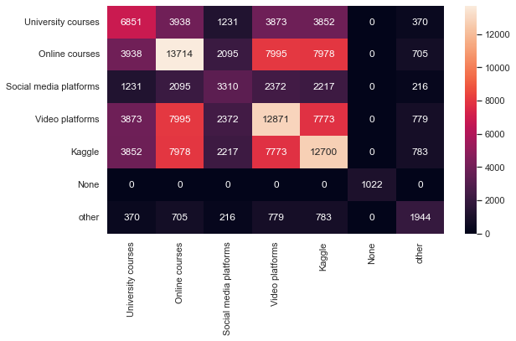

Slide 10
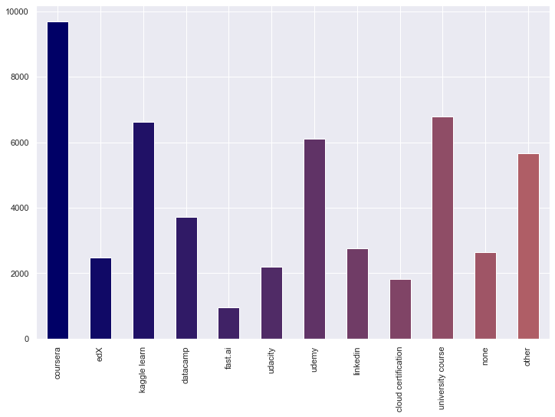
4) On which platforms have you begun or completed data science courses?
As per the data and bar graph plotted, it is analysed that the “COURSERA” is the beginners best choice to start Data Sciences Course.

Slide 11
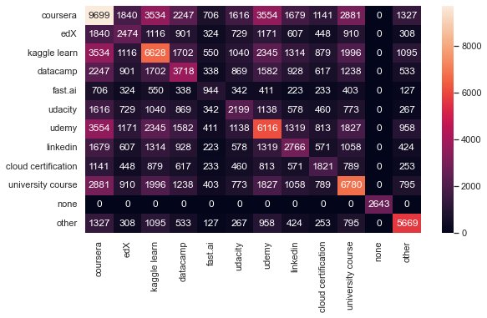

Slide 12
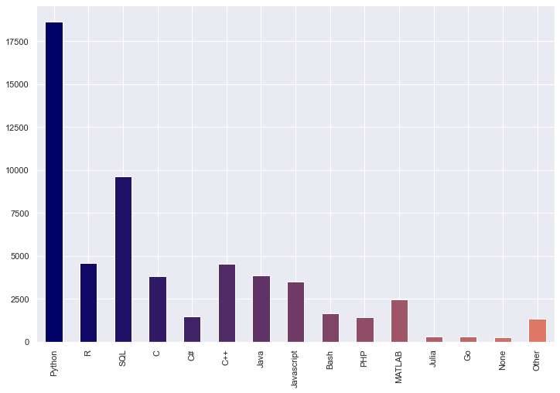
5) What programming languages do you use on a regular basis?
Beginners find “PYTHON” as a suitable programming language to use on a regular basis.

Slide 13
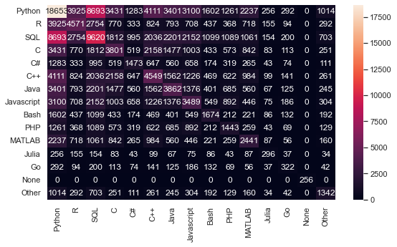

Slide 14
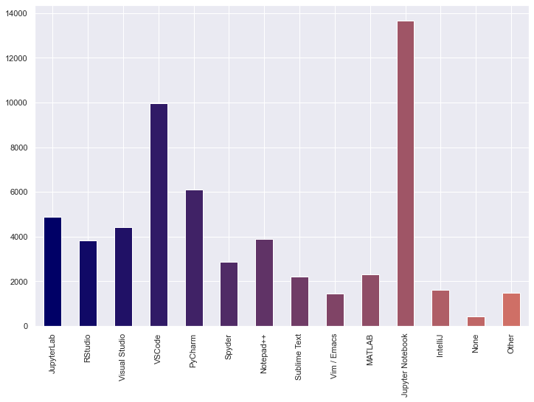
6) Which of the following integrated development environments (IDE's) do you use on a regular basis?
IDE is software for building applications that combines common developer tools into a single graphical user interface (GUI).
“JUPYTER PYTHON” serves the role of best best IDE for newbies.

Slide 15
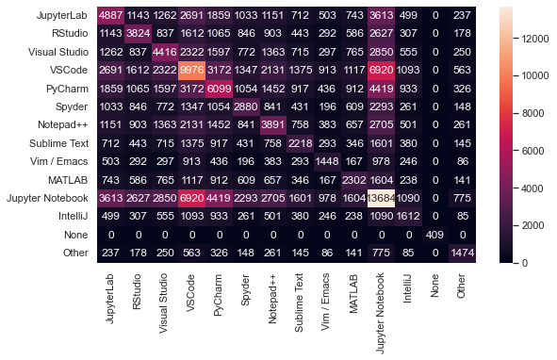

Slide 16
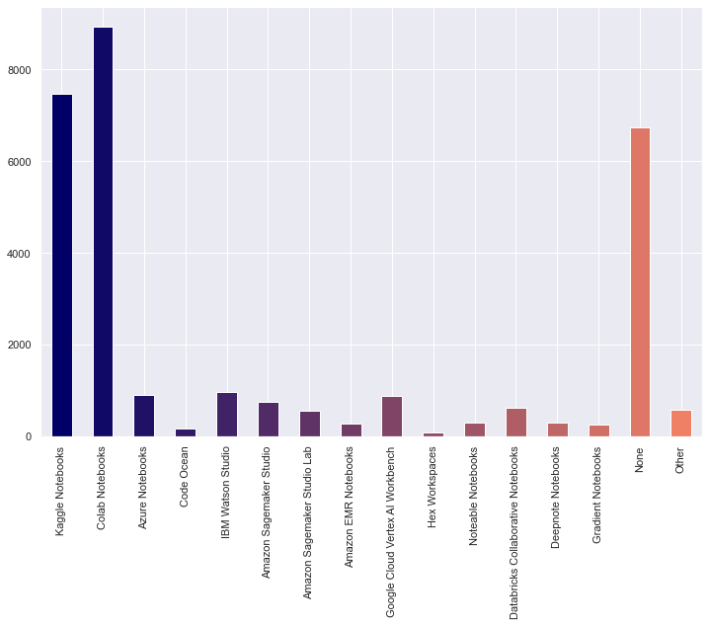
7) Do you use any of the following hosted notebook products?
Google’s “COLAB NOTEBOOK “attracted the users on a high scale to do their programming related activities.

Slide 17
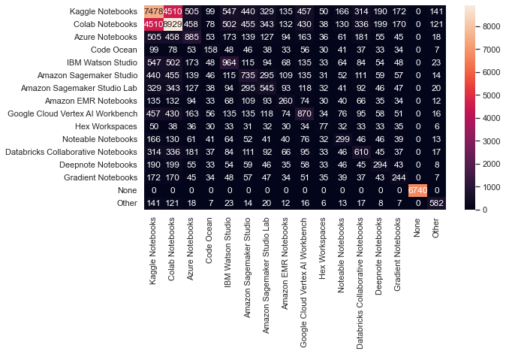

Slide 18
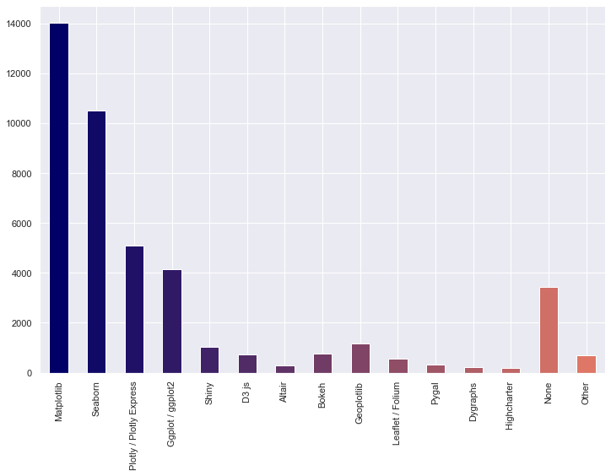
8) Do you use any of the following data visualization libraries on a regular basis?
Data Visualization Library provides detailed graphics with a high level of interactivity across various datasets, whether they are large or small.
“MATPLOTLIB” gained the highest spot as regular used Data Visualization Libraries being used by the beginners frequently.

Slide 19
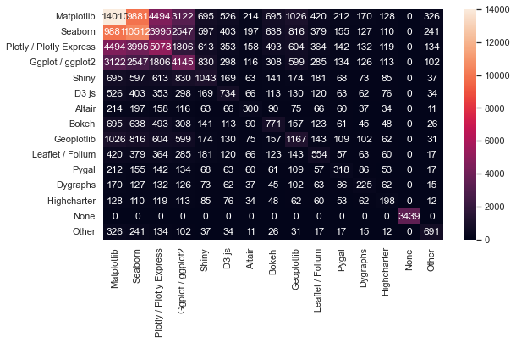

Slide 20
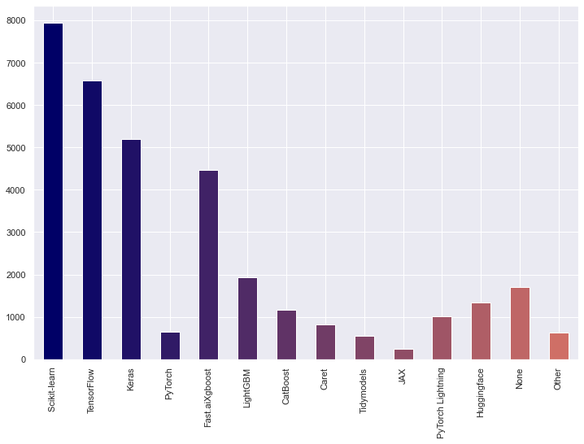
9) Which of the following machine learning frameworks do you use on a regular basis?
Scikit-learn come out as winner followed by TensorFlow for the category of ML framework.

Slide 21
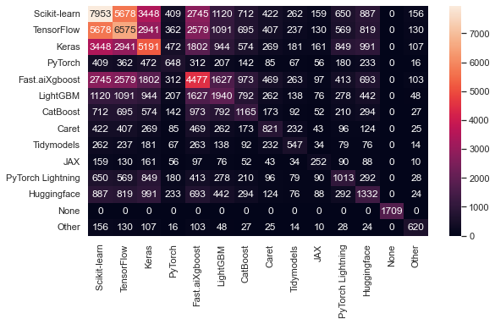

Slide 22
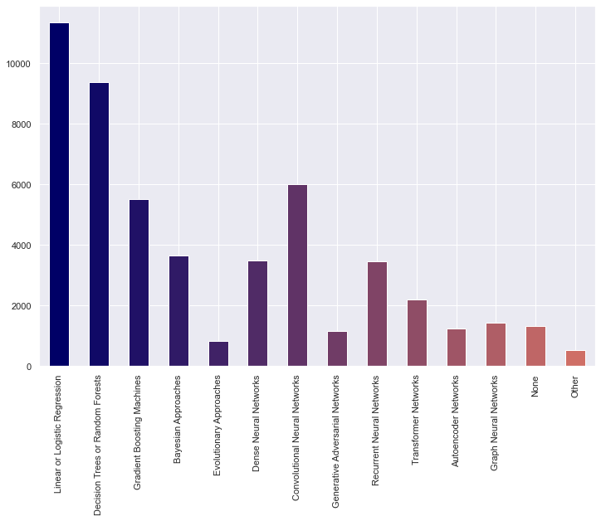
10) Which of the following ML algorithms do you use on a regular basis?
Regression Algos are most common. Linear or logistic serve as the most used ML Algos.
Decision Tree or Random Forest comes in the 2nd place

Slide 23
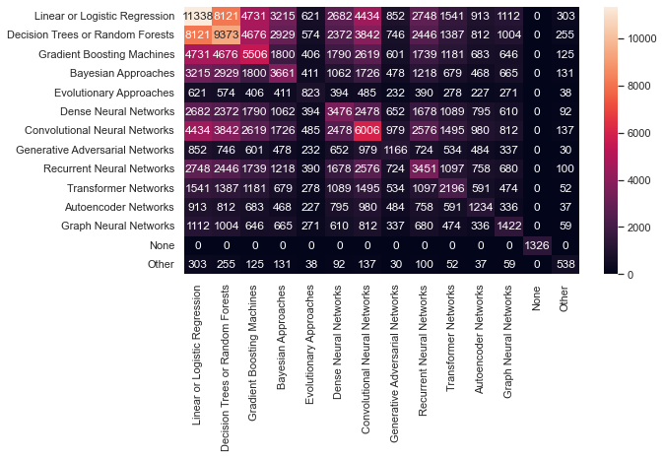

Slide 24
Part 2 :-
What are the ways of staying strong in this field?
=>We have sorted out some features that can help us identify the ways to stay strong in the field of Data Science, these include:-

Slide 25
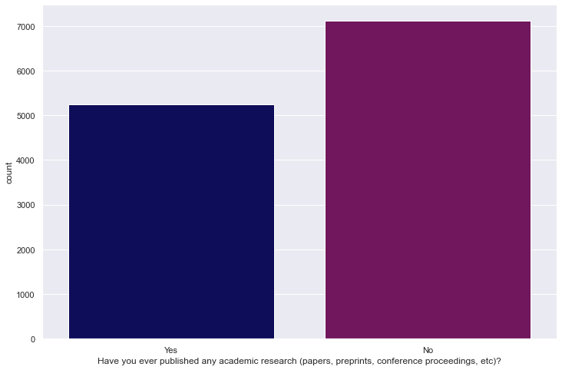
1) Have you ever published any academic research (papers, preprints, conference proceedings, etc)?
It has been seen that most of the people who are in the field of Data Science and ML, haven’t ever published any academic research(papers,preprints,conference proceeding, etc).

Slide 26
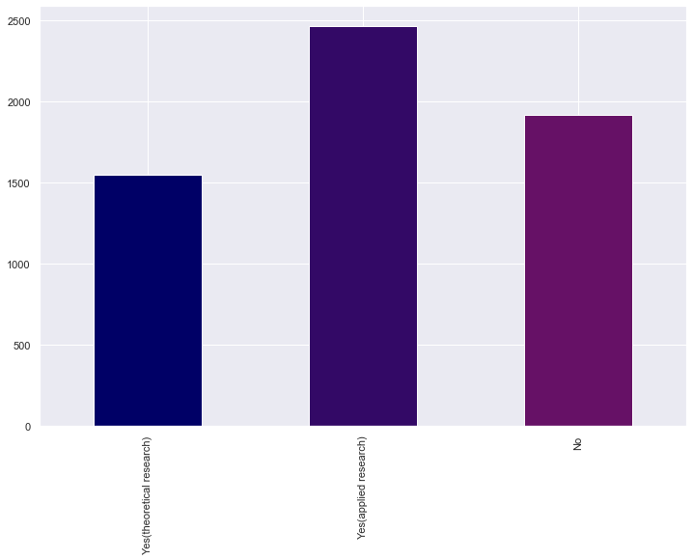
2) Did your research make use of machine learning?
Use of ML is predominately in applied research rather than theoretical research.
A huge section don’t think that ML can help them in research.

Slide 27
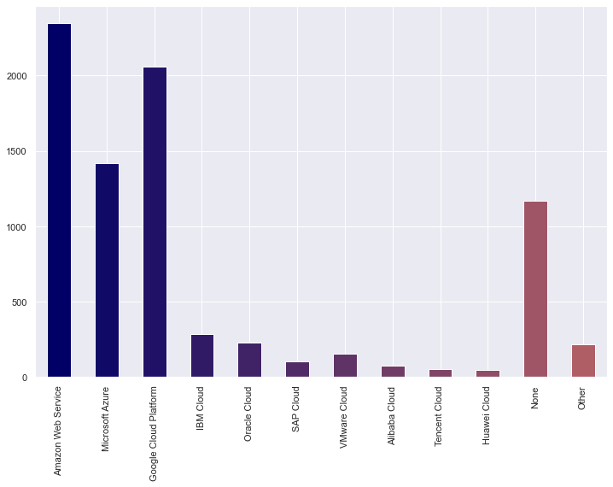
3) Which of the following cloud computing platforms do you use?
AWS servers are most commonly used cloud services followed by Google Cloud.

Slide 28
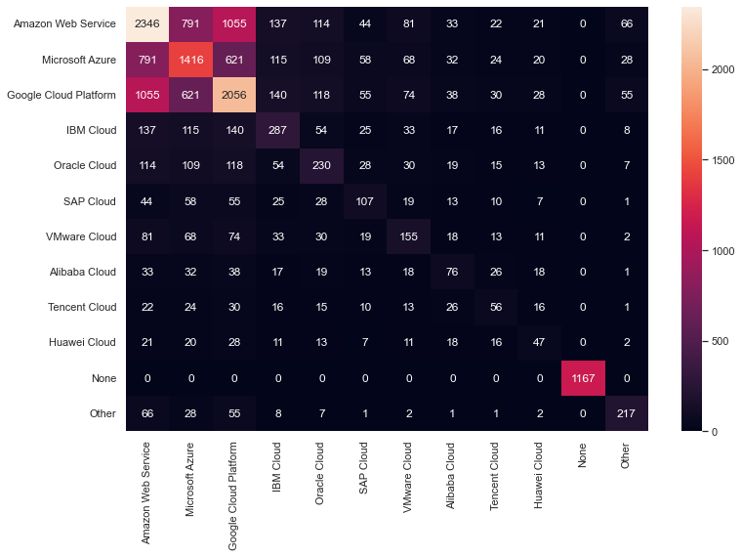

Slide 29
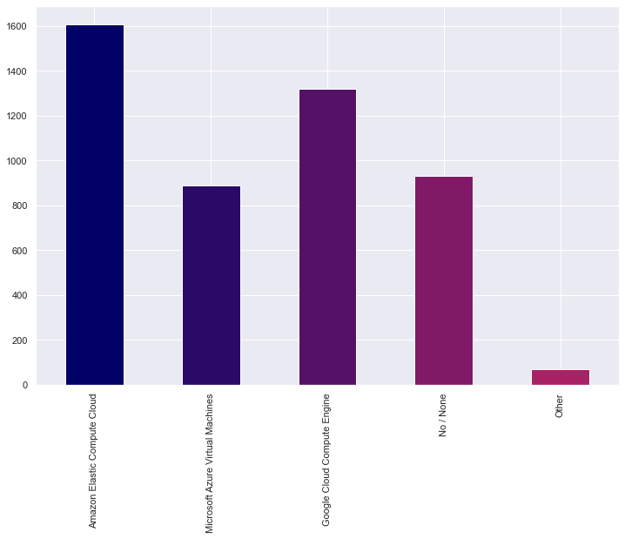
4) Do you use any of the following cloud computing products?
Cloud Computing is the on-demand availability of computer system resources, especially data storage and computing power, without direct active management by the user.
“Amazon Elastic Compute Cloud” is the most used cloud computing products .

Slide 30
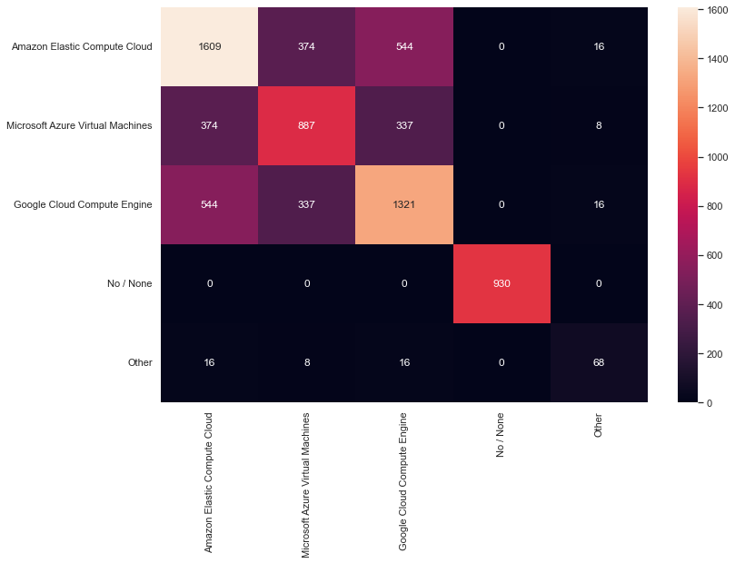

Slide 31
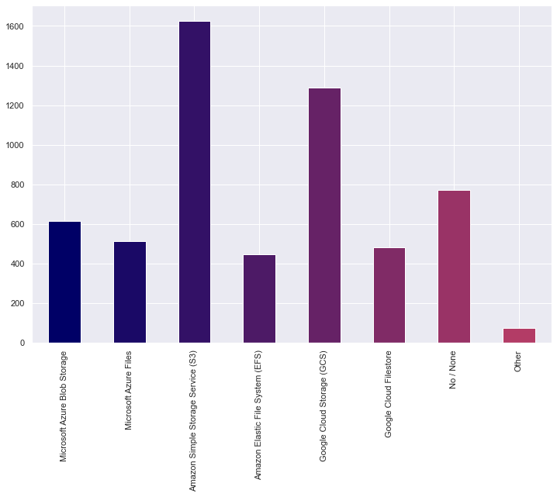
5) Do you use any of the following data storage products?
Data Storage is the recording of information in a storage medium. Handwriting, phonographic recording, magnetic tape, and optical discs are all examples of data storage media.
Here, the highly usable data storage products is found to be “AMAZON SIMPLE STORAGE SERVICE(S3)”.

Slide 32
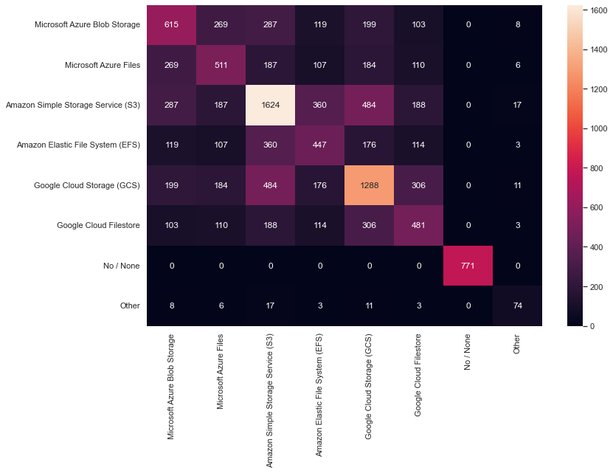

Slide 33
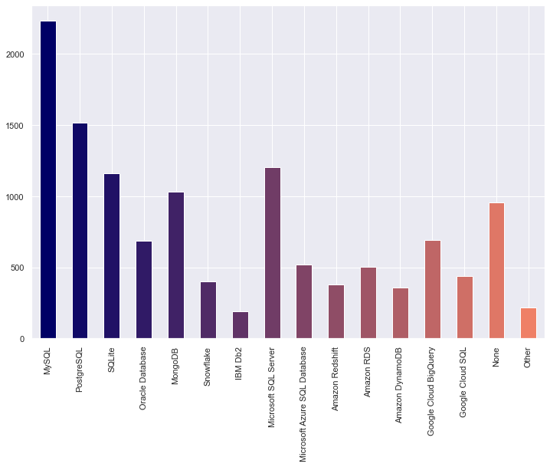
6) Do you use any of the following data products?
Data products have one primary objective: to manage, organize and make sense of the vast amount of data that organizations collect and generate. It’s the users’ job to put the insights to use that they gain from these data products, take actions and make better decisions based on these insights.
MySQL is a widely used open-source relational database management system (RDBMS) and an excellent solution for many applications, including web-scale applications.

Slide 34
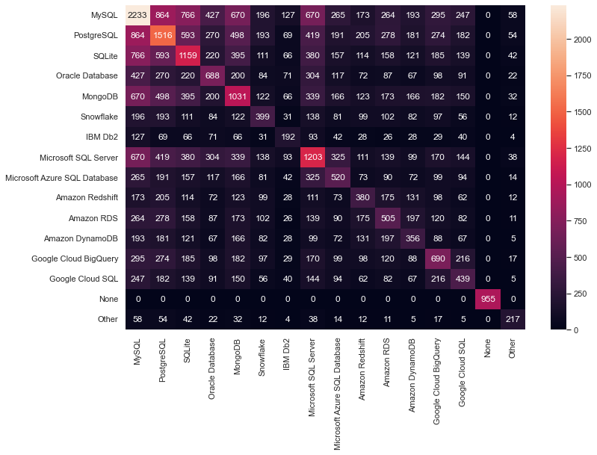

Slide 35
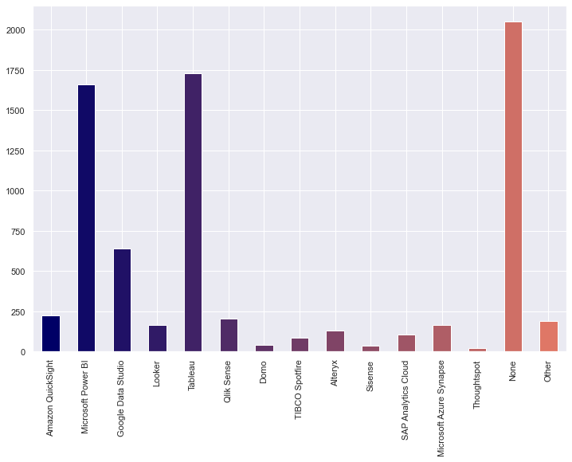
7) Do you use any of the following business intelligence tools?
BI tools are widely used these days. The well-known market leaders Power BI and Tableau are also at the top in this survey. Interestingly, we have quite a lot of respondents using both Tableau and Microsoft Power BI.

Slide 36
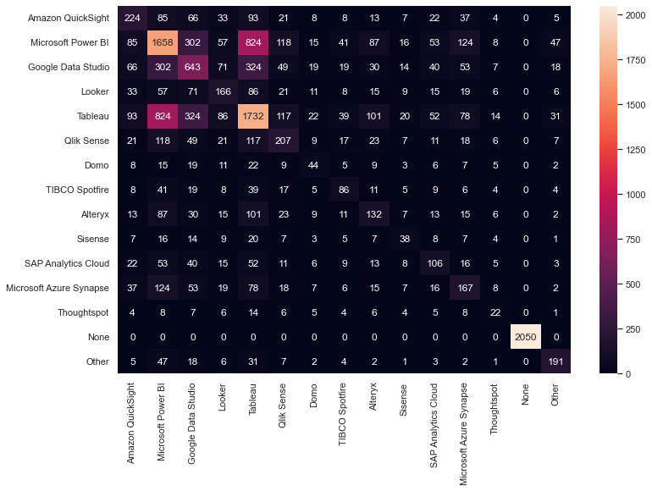

Slide 37
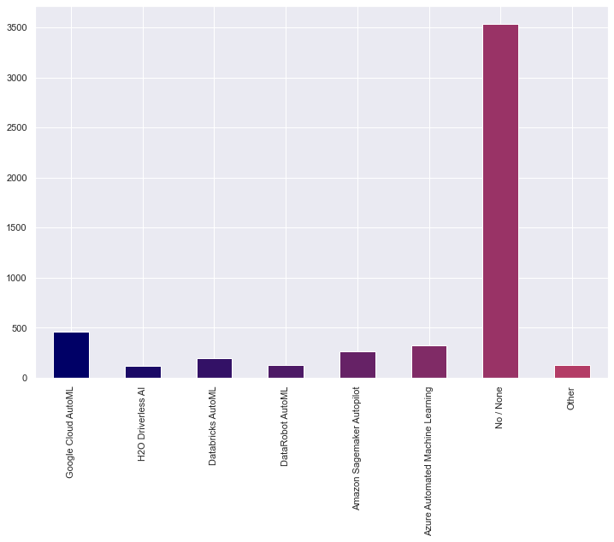
8) Do you use any of the following automated machine learning tools?
Auto ML tools are still not very common. The leader of this survey Google Cloud AutoML, is below 4%.

Slide 38
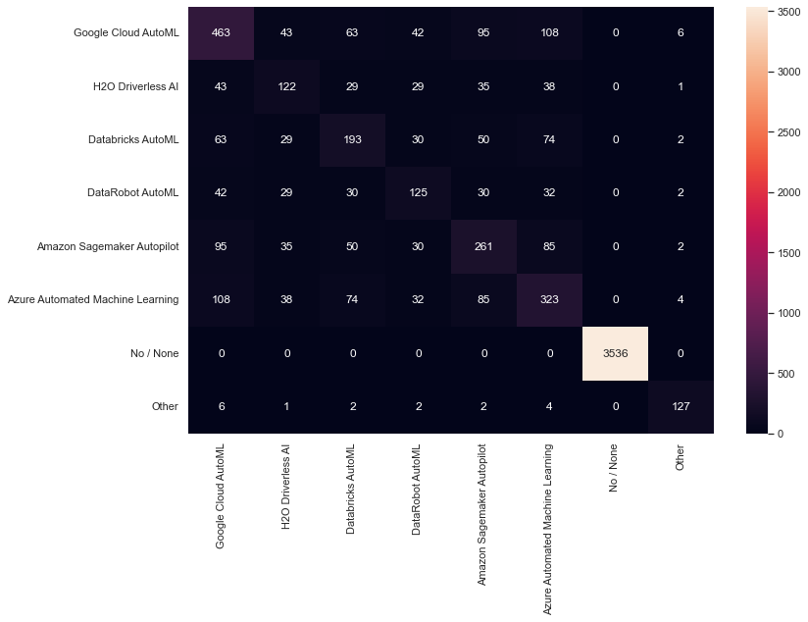

Slide 39
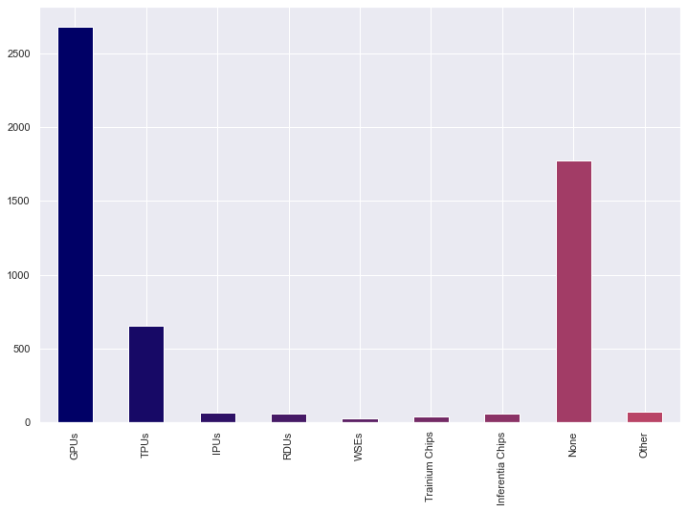
9) Do you use any of the following types of specialized hardware when training machine learning models?
A faster processor will reduce the time it takes to train a machine learning model and to generate predictions by as much as 100-fold or more. There are two primary processors used as part of most AI/ML tasks: central processing units (CPUs) and graphics processing units (GPUs).
(GPUs have enhanced mathematical computation capability)

Slide 40
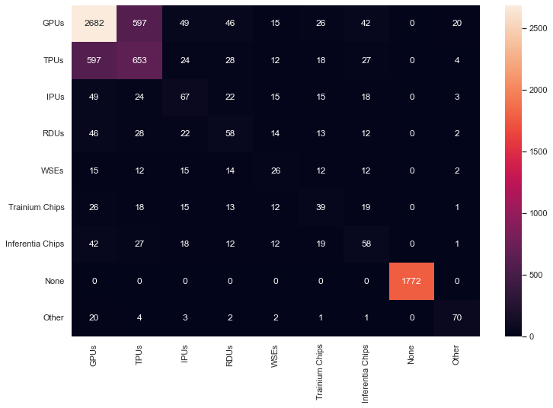

Slide 41
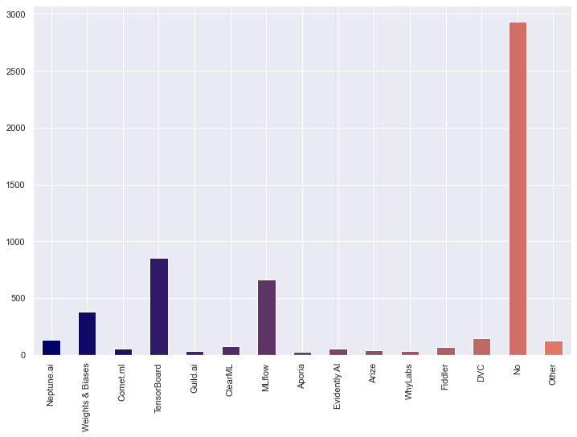
10) Do you use any tools to help monitor your machine learning models and/or experiments?
Machine learning model monitoring is a practice of tracking and analyzing production model performance to ensure acceptable quality as defined by the use case.
The most straightforward way to monitor your ML model is to constantly evaluate your performance on real-world data.
New learners don’t use any kind of tool for taking notes for their progress.

Slide 42
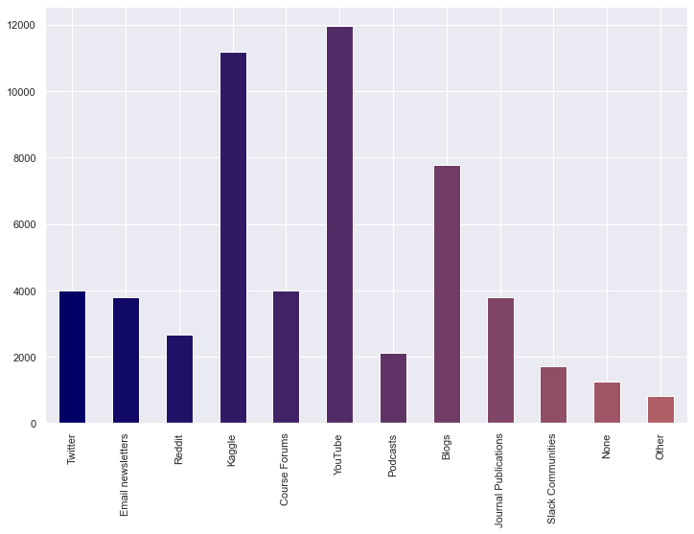
11) Who/what are your favorite media sources that report on data science topics?
Youtube is the most common media platform for data science topics
Kaggle comes second which is mainly used for data sets.
Students also prefer reading Blogs the “classic” way and to be up to date with what all is going on in the field of Data Science, one should be aware with what all is going around in the world.

Slide 43
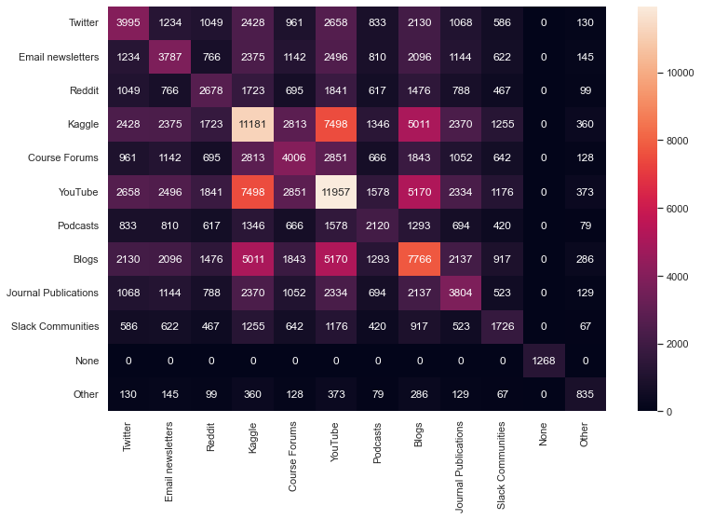

Slide 44
Conclusion:
ROADMAP
Data shows that most of the starters are male and from the age group (18-21).
Students opt for online courses and platforms like Cousera.
Python And Jupyter Python are the popular programming language and notebook.
Matplotlib is the library most used for data visualization.
Most used Machine learning frameworks Scikit-learn.
Regression is the most common Algos followed by Decision Tree or Random Forest.

Slide 45
It has been found that most of the learners who are in the field of ML and Data Science haven’t ever publish any research papers from their side.
In the field of applied research area, the application of Machine Learning is used on high-scale.
Amazon Web Services(AWS) remains at the top of highly used Cloud Computing Platforms.
Amazon Elastic Cloud Compute is the highly used Cloud Computing products.
Amazon Simple Storage Service is the highly usable data storage product.
GPUs have enhanced mathematical computation capability.
New learners don’t use any kind of tool for taking notes for their progress.
Youtube is the most common media platform for data science topics

Slide 46
Problem Statement:
What are the best ways to start in the field of Data Science and ML and the ways of staying strong in this field?

Slide 47
Dataset:
We have been given a dataset in which seems like a survey talking about the ways to get started with Data Science and what are the different aspects that are required for a Data Scientist to do their everyday work.

Slide 48
Part 1:-
What are the best ways to start in the field of Data Science and ML?
=>We have sorted out some features that can help us identify the ways to start a career in the field of Data Science, these include:-

Slide 49
1) Age Range:-
From the plotted bar graph, we see that the people in the age range 18-21 years has started Data Science and ML earlier than other groups.

Slide 50
2) Gender:
Here from our data analysis the gender that dominates the field of ML and Data Science is Male.
Probably the reason behind this is the higher nationwide internet usage rate among men than women, at respectively 57.1 percent of male population and 33.3 percent of female population (as per 2021)

Slide 51
3) What products or platforms did you find to be most helpful when you first started studying data science?
It is evident from the graph that the beginners love to start their Data Science journey through online courses.

Slide 53
4) On which platforms have you begun or completed data science courses?
As per the data and bar graph plotted, it is analysed that the “COURSERA” is the beginners best choice to start Data Sciences Course.

Slide 55
5) What programming languages do you use on a regular basis?
Beginners find “PYTHON” as a suitable programming language to use on a regular basis.

Slide 57
6) Which of the following integrated development environments (IDE's) do you use on a regular basis?
IDE is software for building applications that combines common developer tools into a single graphical user interface (GUI).
“JUPYTER PYTHON” serves the role of best best IDE for newbies.

Slide 59
7) Do you use any of the following hosted notebook products?
Google’s “COLAB NOTEBOOK “attracted the users on a high scale to do their programming related activities.

Slide 61
8) Do you use any of the following data visualization libraries on a regular basis?
Data Visualization Library provides detailed graphics with a high level of interactivity across various datasets, whether they are large or small.
“MATPLOTLIB” gained the highest spot as regular used Data Visualization Libraries being used by the beginners frequently.

Slide 63
9) Which of the following machine learning frameworks do you use on a regular basis?
Scikit-learn come out as winner followed by TensorFlow for the category of ML framework.

Slide 65
10) Which of the following ML algorithms do you use on a regular basis?
Regression Algos are most common. Linear or logistic serve as the most used ML Algos.
Decision Tree or Random Forest comes in the 2nd place

Slide 67
Part 2 :-
What are the ways of staying strong in this field?
=>We have sorted out some features that can help us identify the ways to stay strong in the field of Data Science, these include:-

Slide 68
1) Have you ever published any academic research (papers, preprints, conference proceedings, etc)?
It has been seen that most of the people who are in the field of Data Science and ML, haven’t ever published any academic research(papers,preprints,conference proceeding, etc).

Slide 69
2) Did your research make use of machine learning?
Use of ML is predominately in applied research rather than theoretical research.
A huge section don’t think that ML can help them in research.

Slide 70
3) Which of the following cloud computing platforms do you use?
AWS servers are most commonly used cloud services followed by Google Cloud.

Slide 72
4) Do you use any of the following cloud computing products?
Cloud Computing is the on-demand availability of computer system resources, especially data storage and computing power, without direct active management by the user.
“Amazon Elastic Compute Cloud” is the most used cloud computing products .

Slide 74
5) Do you use any of the following data storage products?
Data Storage is the recording of information in a storage medium. Handwriting, phonographic recording, magnetic tape, and optical discs are all examples of data storage media.
Here, the highly usable data storage products is found to be “AMAZON SIMPLE STORAGE SERVICE(S3)”.

Slide 76
6) Do you use any of the following data products?
Data products have one primary objective: to manage, organize and make sense of the vast amount of data that organizations collect and generate. It’s the users’ job to put the insights to use that they gain from these data products, take actions and make better decisions based on these insights.
MySQL is a widely used open-source relational database management system (RDBMS) and an excellent solution for many applications, including web-scale applications.

Slide 78
7) Do you use any of the following business intelligence tools?
BI tools are widely used these days. The well-known market leaders Power BI and Tableau are also at the top in this survey. Interestingly, we have quite a lot of respondents using both Tableau and Microsoft Power BI.

Slide 80
8) Do you use any of the following automated machine learning tools?
Auto ML tools are still not very common. The leader of this survey Google Cloud AutoML, is below 4%.

Slide 82
9) Do you use any of the following types of specialized hardware when training machine learning models?
A faster processor will reduce the time it takes to train a machine learning model and to generate predictions by as much as 100-fold or more. There are two primary processors used as part of most AI/ML tasks: central processing units (CPUs) and graphics processing units (GPUs).
(GPUs have enhanced mathematical computation capability)

Slide 84
10) Do you use any tools to help monitor your machine learning models and/or experiments?
Machine learning model monitoring is a practice of tracking and analyzing production model performance to ensure acceptable quality as defined by the use case.
The most straightforward way to monitor your ML model is to constantly evaluate your performance on real-world data.
New learners don’t use any kind of tool for taking notes for their progress.

Slide 85
11) Who/what are your favorite media sources that report on data science topics?
Youtube is the most common media platform for data science topics
Kaggle comes second which is mainly used for data sets.
Students also prefer reading Blogs the “classic” way and to be up to date with what all is going on in the field of Data Science, one should be aware with what all is going around in the world.

Slide 87
Conclusion:
ROADMAP
Data shows that most of the starters are male and from the age group (18-21).
Students opt for online courses and platforms like Cousera.
Python And Jupyter Python are the popular programming language and notebook.
Matplotlib is the library most used for data visualization.
Most used Machine learning frameworks Scikit-learn.
Regression is the most common Algos followed by Decision Tree or Random Forest.

Slide 88
It has been found that most of the learners who are in the field of ML and Data Science haven’t ever publish any research papers from their side.
In the field of applied research area, the application of Machine Learning is used on high-scale.
Amazon Web Services(AWS) remains at the top of highly used Cloud Computing Platforms.
Amazon Elastic Cloud Compute is the highly used Cloud Computing products.
Amazon Simple Storage Service is the highly usable data storage product.
GPUs have enhanced mathematical computation capability.
New learners don’t use any kind of tool for taking notes for their progress.
Youtube is the most common media platform for data science topics

